Slide 1

GIT & Github

Slide 2
Introduction

Slide 3
What Is Git and What Is GitHub
Git is a free, open-source, distributed version control system that handles source code changes in software projects of all sizes.
Git allows multiple developers to work together on the same project with ease.
On the other hand, GitHub is a company that offers a cloud-based repository allowing developers to store and manage their code and to track and control code changes.

Slide 4
What is a “version control system”?
Version control systems are a category of software tools that helps in recording changes made to files by keeping track of modifications done in the code.
Why Version Control system is so Important?
As we know that a software product is developed in collaboration by a group of developers they might be located at different locations and each one of them contributes to some specific kind of functionality/features.
So in order to contribute to the product, they made modifications to the source code(either by adding or removing).
A version control system is a kind of software that helps the developer team to efficiently communicate and manage(track) all the changes that have been made to the source code along with the information like who made and what changes have been made.
A separate branch is created for every contributor who made the changes and the changes aren’t merged into the original source code unless all are analyzed as soon as the changes are green signaled they merged into the main source code.
It not only keeps source code organized but also improves productivity by making the development process smooth.

Slide 5
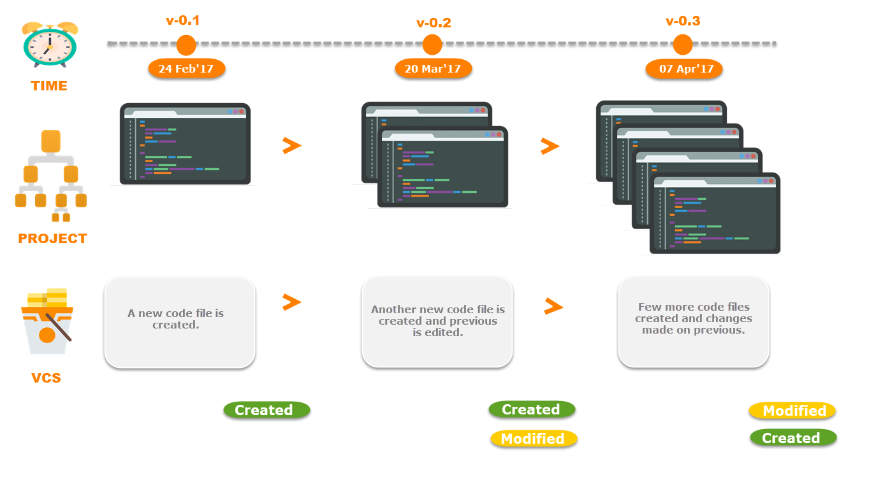
Types of Version Control Systems:
Local Version Control Systems
Centralized Version Control Systems
Distributed Version Control Systems

Slide 6
Local Version Control Systems
It is one of the simplest forms and has a database that kept all the changes to files under revision control.
RCS is one of the most common VCS tools.
It keeps patch sets (differences between files) in a special format on disk.
By adding up all the patches it can then re-create what any file looked like at any point in time.

Slide 7
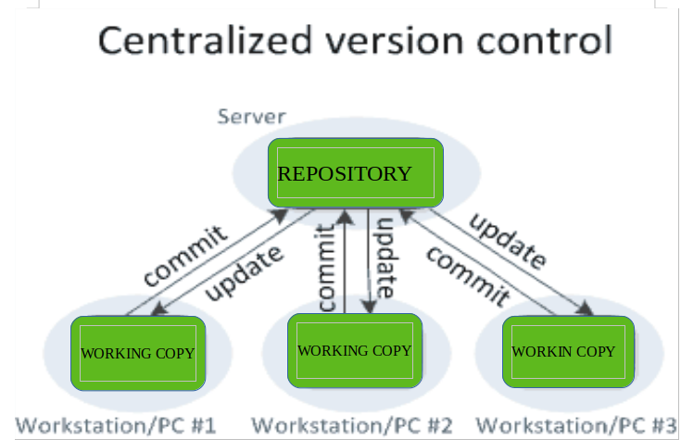
Centralized Version Control Systems
Centralized version control systems contain just one repository globally and every user need to commit for reflecting one’s changes in the repository. It is possible for others to see your changes by updating.
Two things are required to make your changes visible to others which are:
You commit
They update

Slide 8
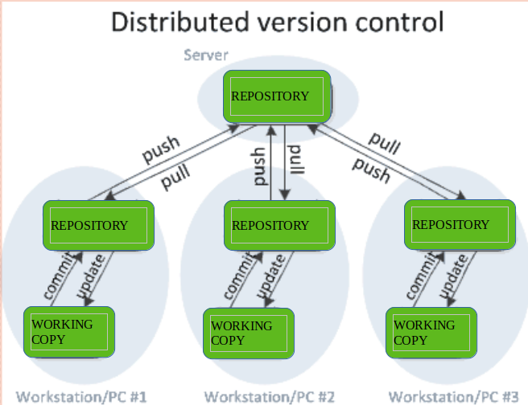
Distributed Version Control Systems
Distributed version control systems contain multiple repositories.
Each user has their own repository and working copy. Just committing your changes will not give others access to your changes.
This is because the commit will reflect those changes in your local repository and you need to push them in order to make them visible on the central repository.
Similarly, When you update, you do not get others’ changes unless you have first pulled those changes into your repository.
To make your changes visible to others, 4 things are required:
You commit
You push
They pull
They update

Slide 9
Top Version Control Systems
There are many Version Control Systems that are available in the market, but a few top VCSs are:
GIT
CVS
SVN
Assembla
Mercurial
Bazaar

Slide 10
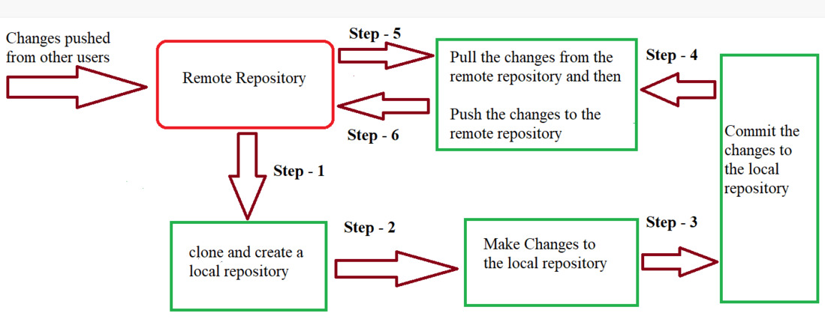
GIT LiFE CYCLE
Git is used in our day-to-day work, we use Git for keeping track of our files, working in collaboration with our team, to go back to our previous code versions if we face some error.
Git helps us in many ways. Let us look at the Life Cycle that git has and understand more about its life cycle.
Let us see some of the basic steps that we follow while working with Git

Slide 11
STEP TO FOLLOW IN GIT
In Step – 1, We first clone any of the code residing in the remote repository to make our own local repository.
In Step-2 we edit the files that we have cloned in our local repository and make the necessary changes in it.
In Step-3 we commit our changes by first adding them to our staging area and committing them with a commit message.
In Step–4 and Step-5 we first check whether there are any of the changes done in the remote repository by some other users and we first pull that changes.
If there are no changes we directly proceed with Step – 6 in which we push our changes to the remote repository and we are done with our work.

Slide 12
When a directory is made a git repository, there are mainly 3 states which make the essence of Git Version Control System. The three states are –
Working Directory
Staging Area
Git Directory

Slide 13
Working Directory
Whenever we want to initialize our local project directory to make it a git repository, we use the git init command.
After this command, git becomes aware of the files in the project although it doesn’t track the files yet.
The files are further tracked in the staging area.
git init

Slide 14
Staging Area
Now, to track the different versions of our files we use the command git add.
We can term a staging area as a place where different versions of our files are stored.
git add command copies the version of your file from your working directory to the staging area.
We can, however, choose which files we need to add to the staging area because in our working directory, there are some files that we don’t want to get tracked, examples include node modules, env files, temporary files, etc.
Indexing in Git is the one that helps Git in understanding which files need to be added or sent.
You can find your staging area in the .git folder inside the index file.
// to specify which file to add to the staging area
git add <filename>
// to add all files of the working directory to the staging area
git add .

Slide 15
Git Directory
We have all the files that are to be tracked and are ready in the staging area, we are ready to commit our files using the git commit command.
Commit helps us in keeping track of the metadata of the files in our staging area.
We specify every commit with a message which tells what the commit is about.
Git preserves the information or the metadata of the files that were committed in a Git Directory which helps Git in tracking files and basically, it preserves the photocopy of the committed files.
Commit also stores the name of the author who did the commit, the files that are committed, and the date on which they are committed along with the commit message.
git commit -m <Commit Message>

Slide 16
Create a GitHub Account
After installing Git on your machine, the next step is to create a free GitHub account.
Follow these steps:
1. Visit the official account creation page: https://github.com/
2. Pick a username, enter your email address, and choose a password.
3. Receiving updates and announcements by checking/unchecking the Email preferences checkbox.
4. Verify you're not a robot by solving the Captcha puzzle.
5. Click Create an Account.

Slide 17
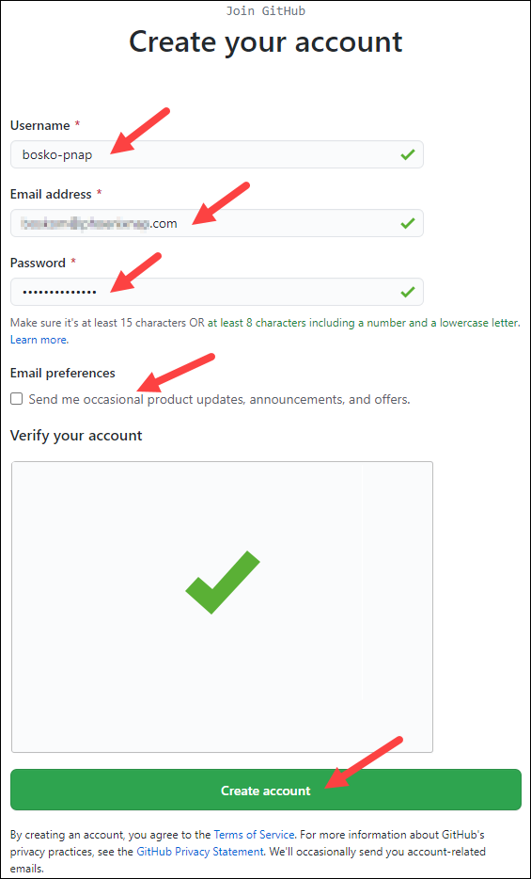
6. GitHub sends a launch code to the specified email address. Copy-paste the code in the designated field.
7. Optionally, enter account personalization details when asked or Skip, and click Continue.
You have now successfully created a GitHub account.

Slide 18

Step 2: Create a Local Git Repository
After installing or updating Git, the next step is to create a local Git repository.
To create a Git repository, follow the steps below:
1. Open a Git Bash terminal and move to the directory where you want to keep the project on your local machine. For example:
cd ~/Desktop
mkdir myproject
cd myproject/
In this example, we changed the directory to Desktop and created a subdirectory called myproject.
2. Create a Git repository in the selected folder by running the git init command. The syntax is:
git init [repository-name]

Slide 19
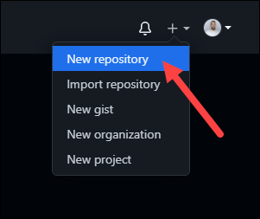
Step 3: Create a New Repository on GitHub
GitHub allows you to keep track of your code when you're working with a team and need to modify the project's code collaboratively.
Follow these steps to create a new repository on GitHub:
1. Log in and browse to the GitHub home page.
2. Find the New repository option under the + sign next to your profile picture, in the top right corner.

Slide 20
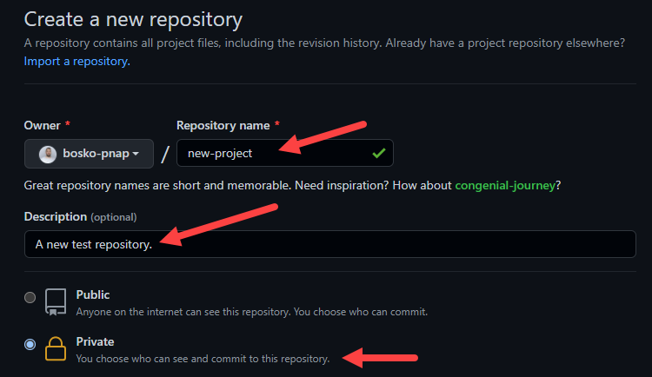
3. Enter a name for your repository, provide a brief description, and choose a privacy setting.

Slide 21
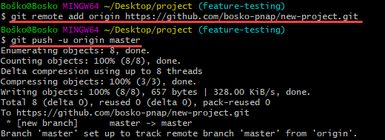
4. Click the Create repository button.
GitHub allows you to add an existing repo you have created locally. To push a local repository from your machine to GitHub, use the following syntax:
git remote add origin https://github.com/[your-username]/[repository-name.git]
git push -u origin master

Slide 22
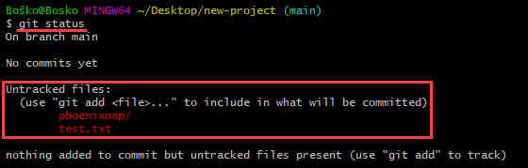
Step 4: Add a File to the Repository
Git notices when you add or modify files in the folder containing the Git repository but doesn't track the file unless instructed. Git saves the changes only for the files it tracks, so you need to let Git know you want to track changes for a specific file.
You can check which files Git is tracking by running:
git status

Slide 23
Step 5: Unstage Files on Git
Working with Git usually involves adding all the files to your index to prepare them for a commit. If you want to remove some files from the index before committing, you have to unstage the files in Git.
One way to unstage files on Git is to run the git reset command. The syntax is:
git reset [commit] -- [file_path]

Slide 24

Step 6: Create a Commit
After adding the specified files to the staging environment, instruct Git to package the files into a commit using the git commit command.
Git then stores that file version. You can review the stored version at any given time.
The syntax is:
git commit -m "Notes about the commit"
Add a message at the end of the commit to state whether it's a new feature, a bug fix, or anything else.
Commits remain in the repository, and they are rarely deleted, so an explanation of what you changed helps other developers working on the project or helps you keep track of all the changes.

Slide 25
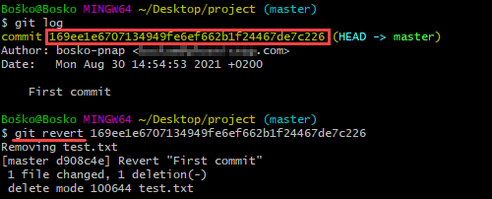
Step 7: Undo Last Commit
Use the revert and reset commands to undo changes and revert to a previous commit.
To undo a published commit, use the following syntax:
git revert [hash]
A hash is a code that identifies each commit. Obtain a commit hash by running:
git log
In this example, we first ran the git log command to obtain the commit hash and then reverted the last commit by running git revert with the commit hash we obtained.

Slide 26
Step 8: Create a New Branch
The first branch in a git repository is called master, and it is the primary branch in a project.
Creating a new Git branch means creating a copy of the project from a specific point in time. Branches in Git allow users to make new features without applying the changes to the main branch while the feature is in development.
The common method for creating a new branch is by running:
git branch [new_branch_name]

Slide 27

Step 9: Switch Branches
Having several branches of a Git project provides a test environment for developers to track progress without affecting the production version of an application. Git allows you to switch between branches with the checkout command easily. The syntax is:
git checkout [branch_name]
Replace [branch_name] with the branch name you want to access.
For example:

Slide 28

Step 10: Rename a Local or Remote Git Branch
In Git, you can rename a local or remote Git branch.
The syntax for changing a local Git branch name is:
git branch -m new-name
For example:
Changing a local branch name in Git.
In this example, we changed the local branch name from new-feature to feature-testing.
Since there isn’t a way to directly rename a remote Git branch, you first need to delete the old branch name, then push the new branch name to the remote repository.

Slide 29

Step 11: Delete a Local or Remote Git Branch
You may decide to delete a Git branch after merging the changes with the master branch or if the branches become corrupted.
You can delete local and remote Git branches.
Deleting a local branch doesn't affect a remote branch. To delete a local Git branch, run:
git branch -d [branch_name]
Use the following syntax to delete a remote Git branch:
git push [remote_project] --delete [branch_name]
In this example, we deleted a local Git branch:

Slide 30
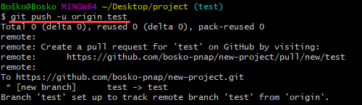
Step 12: Set Upstream Branch
Sending something upstream in Git means that you are sending it back to the repository owner.
Using the git set upstream command, you can choose the flow direction of your current local branch. The command also allows you to change the default remote branch.

Slide 31
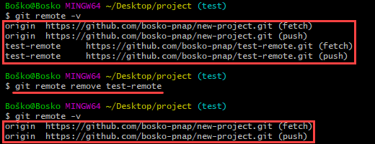
Step 13: Remove a Git Remote
A git remote is a connection to a repository hosted on a remote server – GitHub, BitBucket, GitLab, or any other remote location.
However, over time, the remote repository may move to another host, or a team member may stop working on the project. The remote in question is then no longer needed.
There are several ways to remove a Git remote. One of the ways is to delete a remote using the command line. The syntax is:
git remote remove [remote name]
In the following example, running git remote -v shows the available remotes, 'origin' and 'test-remote.' After removing 'test-remote' and rerunning git remote -v to list available remotes, we see that the only available remote is 'origin.'

Slide 32
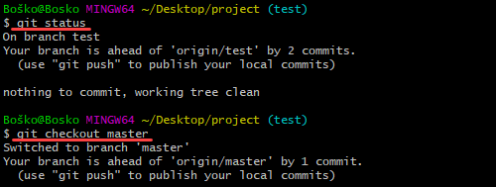
Step 14: Git Merge
Git merge unifies multiple commit sequences into a single commit. It can combine two branches, thus integrating the independent development lines into a single branch.
After merging two branches, Git updates the current branch to reflect the merge, but the target branch isn't affected. That means you have to use the git branch -d command to delete the obsolete target branch.
For example, you may want to merge a new feature branch into the main branch. Follow the steps below:
1. Run the git status command to ensure that HEAD is pointing to the correct merge-receiving (master) branch. If it is not, run git checkout master to switch to the master branch.

Slide 33

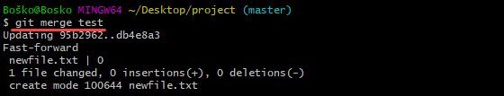
2. Run git fetch to pull the latest remote commits and git pull to ensure the main branch has the latest updates.
3. Run git merge X where X is the name of the branch you want to merge into the receiving branch.

Slide 34
Step 15: Resolve Merge Conflicts
Merge conflicts usually occur when multiple developers work on the same code of a project or when they work with several development branches.
Git merge warns the user about these conflicts.
Although most merge conflicts resolve automatically, there are cases when git merge cannot resolve an issue.

Slide 35
Step 16: Create a Pull Request
Create a pull request (PR) to inform a repository owner that they should review the changes you've made to their code. Then the owner can approve the pull request and merge the changes into the main repository.
If you are the co-owner or owner of a repository, you don't have to create pull requests to merge your changes. However, you can still do it to keep track of your feature updates and history.
Follow the steps below:
1. In Git Bash, create an empty readme file by running touch readme. md.
2. Create and switch to a new branch on which to modify the file. Run:
git checkout -b create-readme-file
3. Open the readme file in a text editor and add the text you want it to contain. In this example, we will use the Nano text editor to modify the file within the command line window. Run nano readme. md.

Slide 36
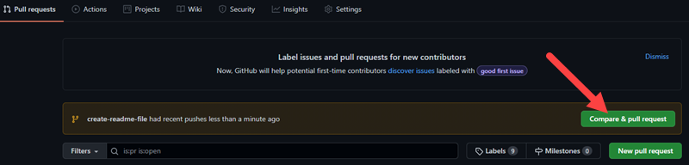
4. After you save the file, track it by running git add readme.md.
5. Create a commit.
git commit -m "Added a readme file"
6. Push the changes to GitHub.
git push origin create-readme-file
7. Log in to your GitHub page. There is now a Create pull request option in your repository with the branch name we created in the command line. Click the Compare & pull request button.

Slide 37
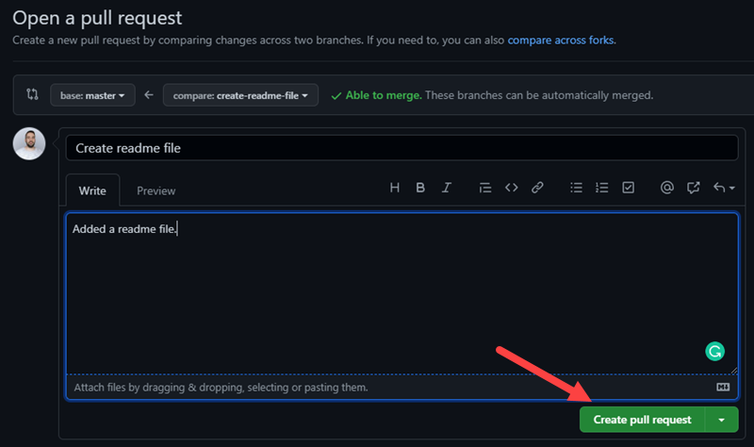
8. GitHub states if you can merge the branches and apply the changes. Optionally, add a comment about your pull request and click Create pull request.
Now the repository owner, in this case, you, can review the changes and accept or reject them.
You can accept the changes in the Pull requests tab on GitHub. When you merge the branches, delete the obsolete branch by clicking Delete branch to keep the repository clean.

Slide 38
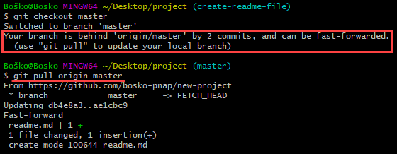
Step 17: Synchronize Changes on GitHub and Locally
When you merge changes on GitHub, they don't appear automatically in your local repository. You have to pull the changes to your local repository to see the updates.
Synchronize your local repository with GitHub by running:
git pull origin master
The command updates your local repository to match the one on GitHub, and states the changes.
In the following example, we first switched to our master branch, and Git warned us that we should update our local repository:

Slide 39
THANK YOU

